Slide 1

Oinos Fast Food & Fine dining
Made by: István Balla & Ádám Ákos Racskó

Slide 2
Introduction
Welcome to our presentation on our online ordering system/table booking for our restaurant.
Our goal is to make ordering and reservations easier and more convenient for customers and the work restaurant staff.

Slide 3
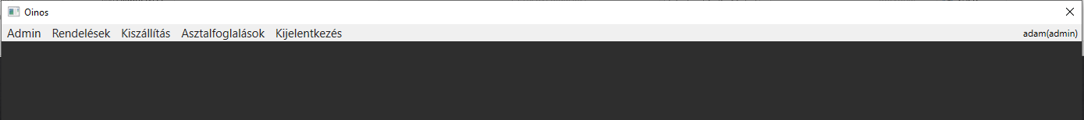
Introduction
Our software is designed to create an efficient and streamlined ordering process for restaurants.
It allows customers to place orders, make reservations, and view menus online, saving them time and hassle.
Restaurant staff can manage accounts, update menus, and view reservation details from an admin panel, making their job easier and more efficient.
For example, you can take a look at the admin’s available tools.

Slide 4
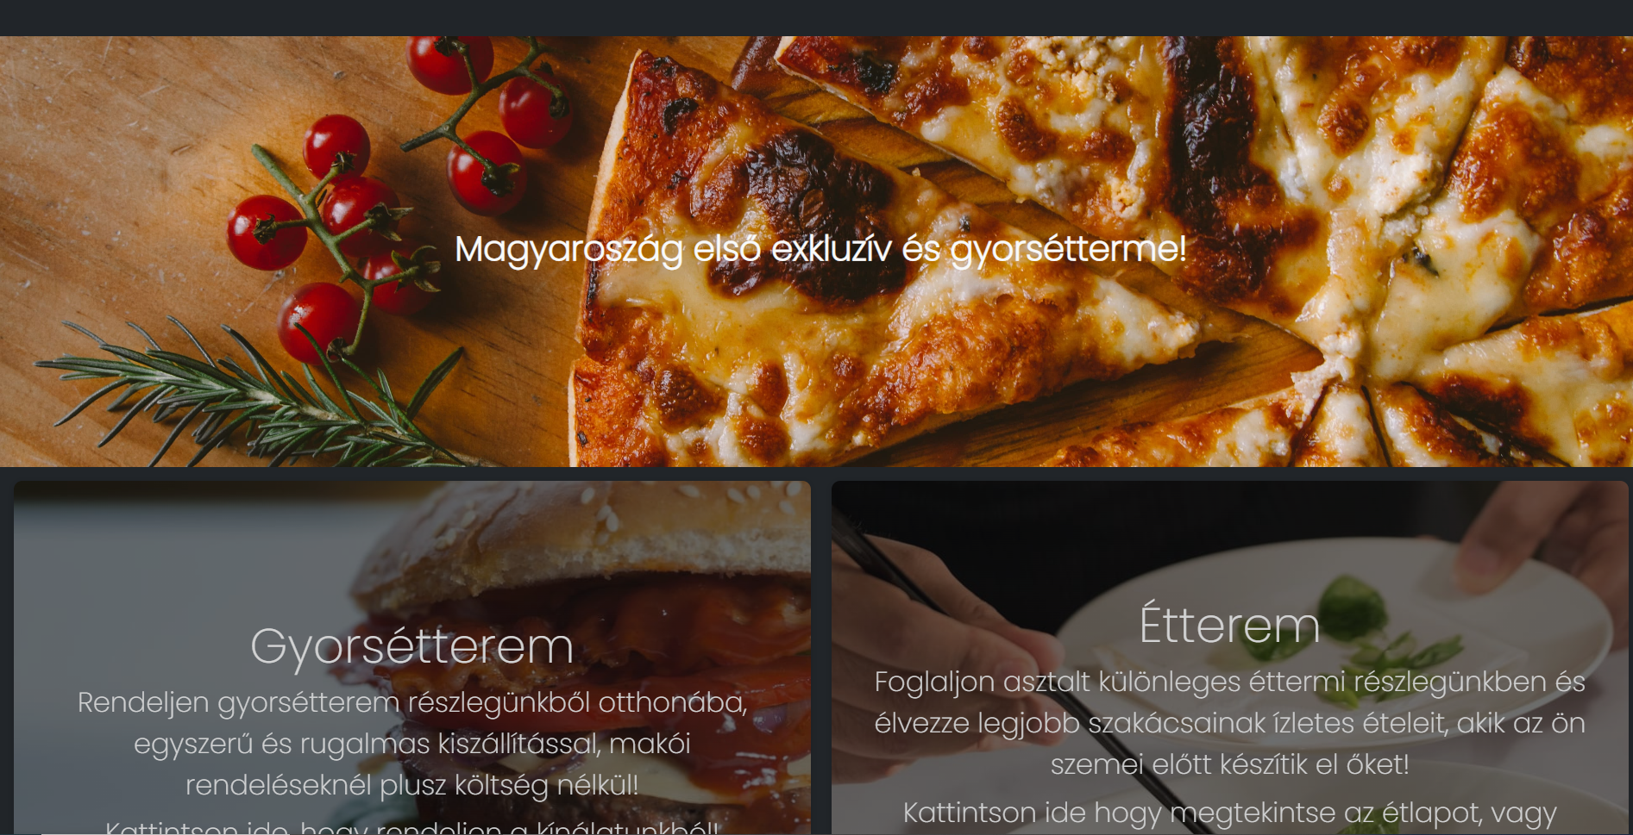
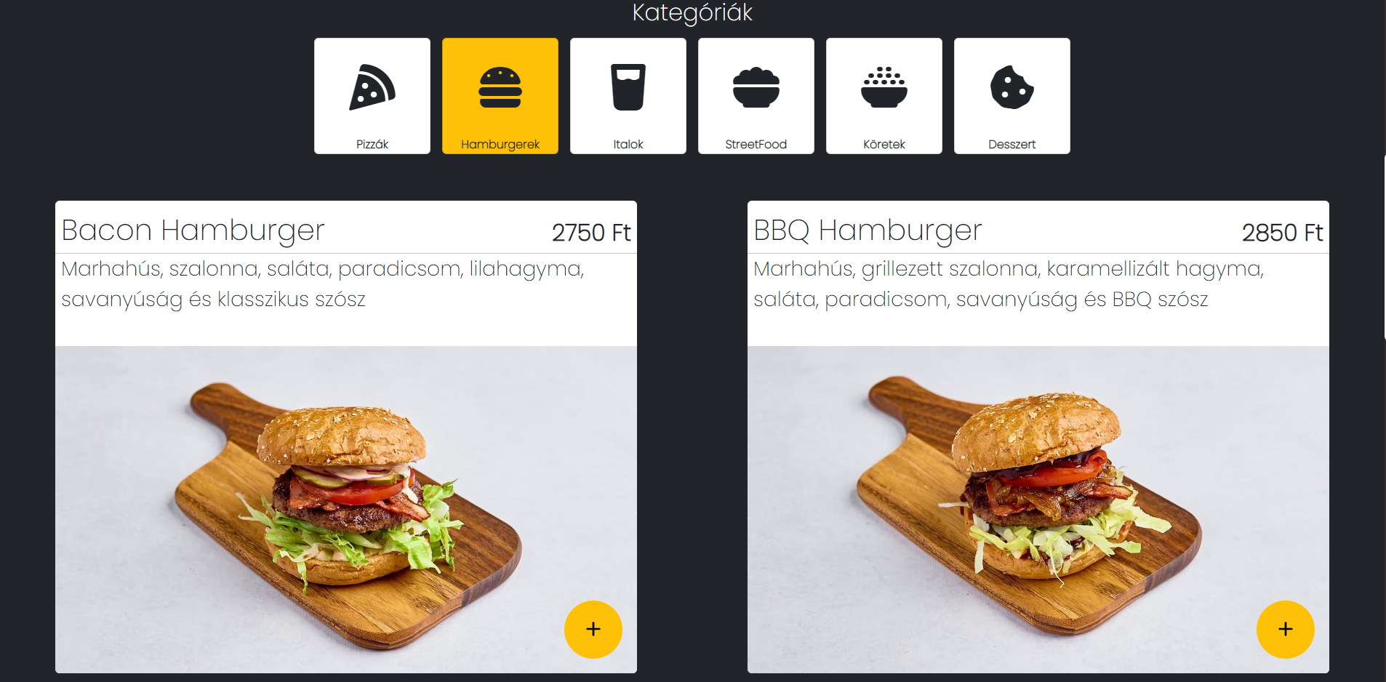
Website Design
Our restaurant website is designed to be visually appealing and easy to navigate for customers.
The layout is simple and intuitive, allowing customers to easily find what they're looking for.
The color scheme is warm and inviting, creating a welcoming atmosphere for customers.

Slide 5
Structure - web
Ordering food (fast food)
User creation
Navigation
About the company: FAQ, Contact, About us.
Table reservations (fine dining)
View menu (restaurant+fast food)
Delete user data
Change your user details
Order History

Slide 6
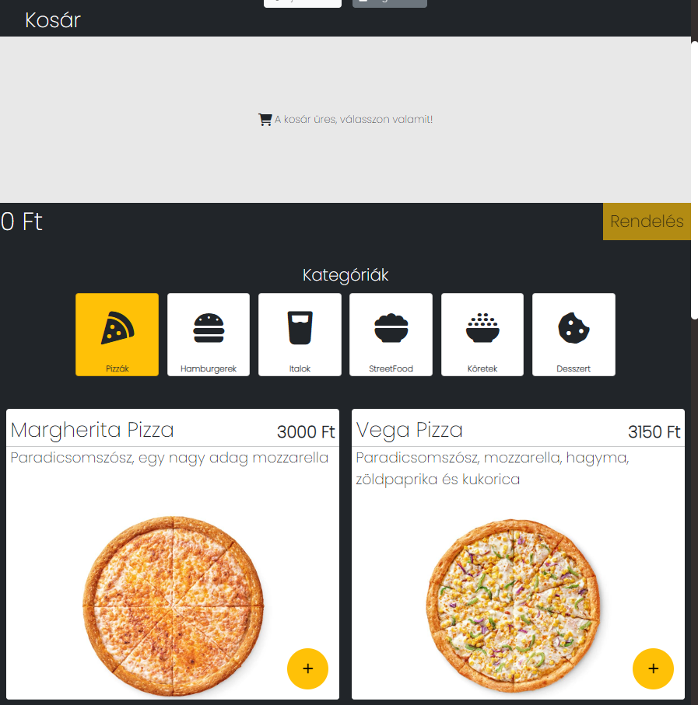
Ordering food (fast food)
Through this menu item, users will be able to order their fast foodorder food from the fast food restaurant. To do this, they select the food they want, add it to the basket and thenfollow the steps of the ordering process.
This code is a JavaScript program that utilizes the AngularJS framework to send a HTTP POST request to a PHP endpoint to retrieve data from a database. The retrieved data populates a menu of food items that can be added to a shopping cart. The program includes functions for updating the cart, filtering items in the menu, and processing payment details. Additionally, the program checks if the user is logged in and adjusts the order details accordingly.

Slide 7
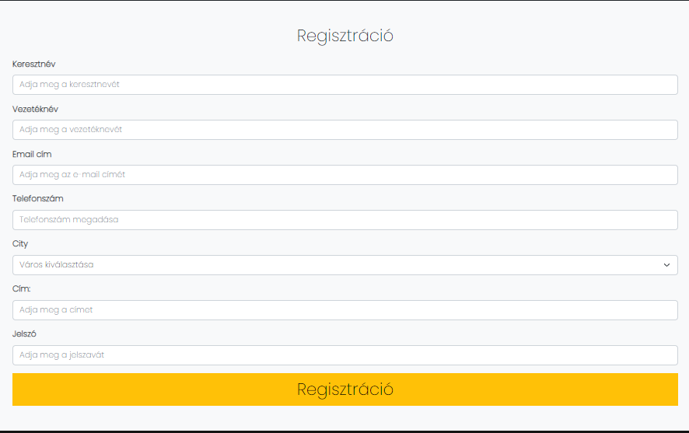
User creation
The user creation menu allows visitors to create their owncreate their own user account on the website. The information required to register: name, email address, password, phone number and address
The register function checks for validation errors and sends a HTTP POST request to a PHP endpoint to register the user's information. If the registration is successful, the user's information is stored in localStorage and the user is redirected to the home page.
The login function sends a HTTP POST request to a PHP endpoint to verify the user's login information. If the login is successful, the user's information is stored in localStorage and the user is redirected to the home page.
The logout function removes all data related to the user from localStorage and updates the $rootScope values. The user is then redirected to the home page.

Slide 8
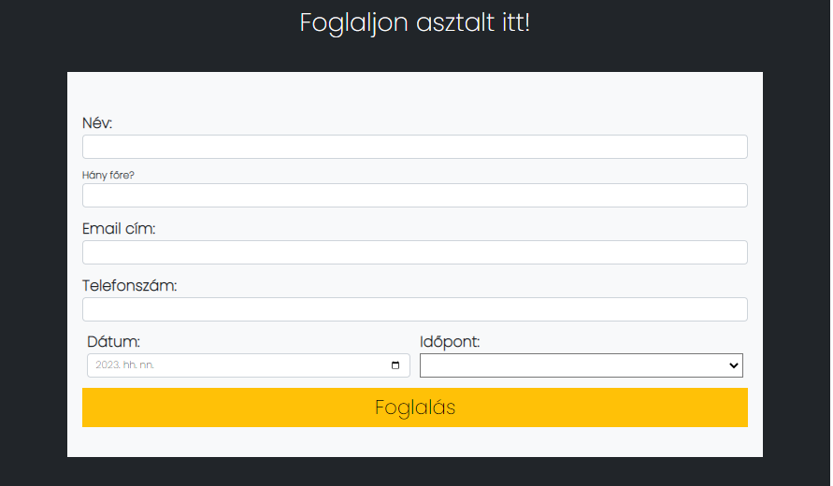
Table reservations (fine dining)
This code defines the controller for the reservation page of a website. It initializes an array to store time options and creates an array of available time options from 6:00 to 21:30 in 30-minute increments.
The controller also has functions to validate the selected date, email, and phone number, and a function to submit the form. The validate functions use regular expressions to validate email and phone number formats.
The submitForm function checks for validation errors and uses the Moment.js library to format the selected date and time. It then adds the combined date and time to the formData object and sends it to a PHP script using the $http service. If the submission is successful, a Bootstrap modal with a success message is displayed, and the user is redirected to the home page. If there is an error, a modal with an error message is displayed, and the error is logged to the console.

Slide 9
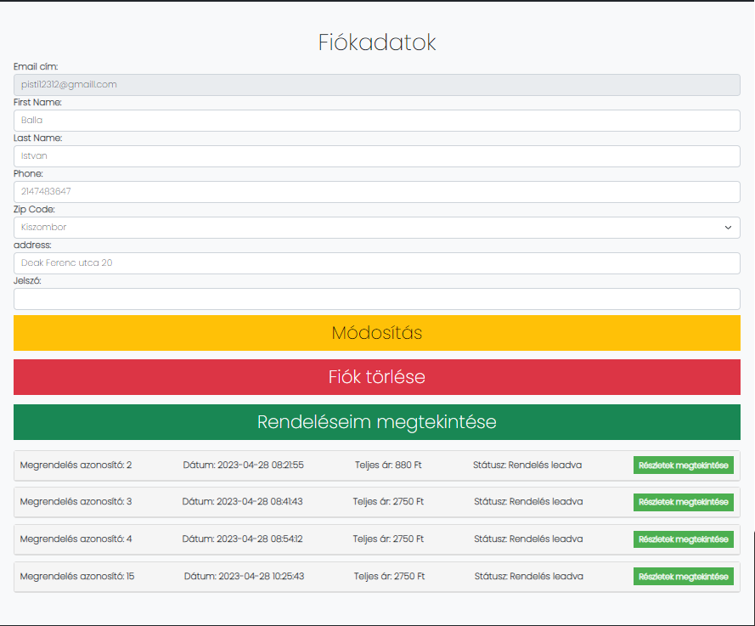
User Details – Modify, Delete, Orderhistory
This is a AngularJS controller for the user details page. It is responsible for handling user data and updating it in the database, displaying user orders and order details.
The controller starts by defining its dependencies and initializing the user data. It also includes a function to delete the user account, which prompts the user with a confirmation dialog before sending an HTTP request to the server to delete the account.
The updateUserData function is called when the user clicks the "Update" button to save any changes made to their user data. This function sends an HTTP request to the server to update the user's data in the database, and then updates the user's data in local storage.
The showOrders function is called to display the user's orders. This function sends an HTTP request to the server to retrieve the user's orders and groups them by their order ID for easier display.
The showOrderDetails function is called when the user clicks on an order to show its details. This function sends an HTTP request to the server to retrieve the items in the selected order and displays them in a table.
Overall, this controller provides functionality for managing user data, deleting user accounts, and displaying user orders and order details.

Slide 10
Technical Implementation
Our project was a group effort that required collaboration and coordination to ensure that each aspect of the software/web was designed and implemented correctly.
We used Trello to organize tasks and deadlines, Figma for design mockups, Git for version control and Discord to communicate and coordinate with team members.
Our software incorporates an SQL database to store customer data and order history, and every other component in the database and we made sure to compress images and ensure that all icons and graphics were legally sourced.

Slide 11
Future Development
In the future, we plan to add additional features to our software, such as the ability to schedule pickup times and track the exact delivery status.
We also hope to improve the user interface and make the ordering process even more streamlined and efficient.
With continued development and improvements, we believe that our website has the potential to revolutionize the restaurant industry and make ordering and reservations easier and more convenient for customers.

